Slide 1
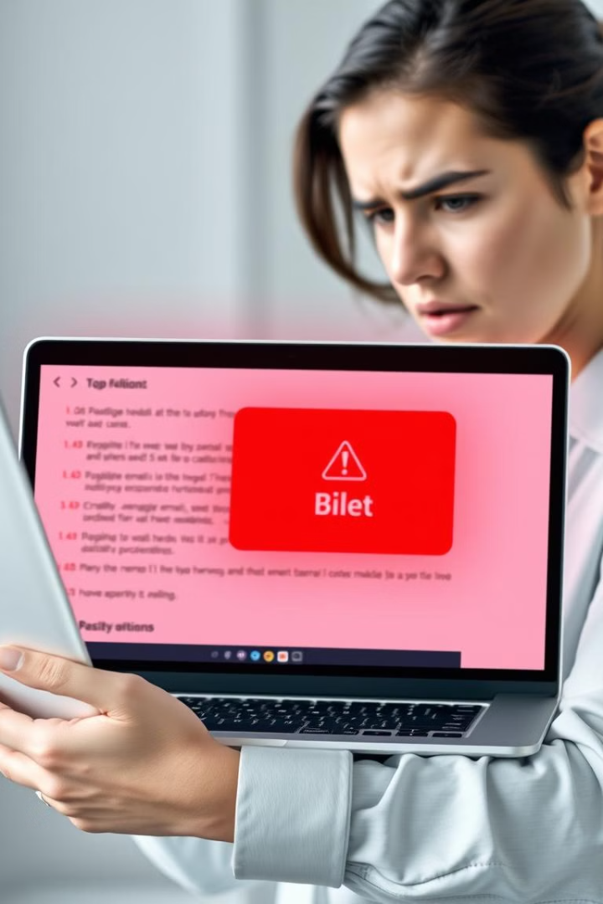
Phishing Awareness
Phishing is a form of cybercrime that uses deceptive tactics to steal personal information.
Presented by Surajj Shinde.

Slide 2
What is Phishing?
Deception
Information Theft
Attackers use deceptive emails, websites, or messages to trick victims into revealing sensitive information.
The goal is to steal personal data, such as passwords, credit card numbers, or bank account details.

Slide 3
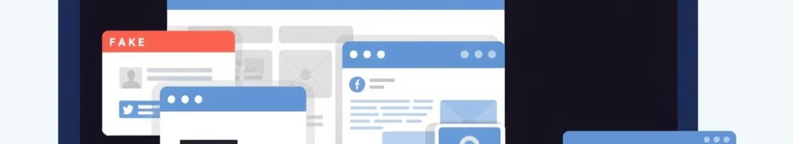
Types of Phishing Attacks
Email Phishing
Smishing
Attackers send emails disguised as legitimate communications from trusted sources.
Phishing attacks conducted via SMS messages, often mimicking official notifications.
Vishing
Spear Phishing
Attackers use voice calls to deceive victims into revealing personal information.
Highly targeted attacks, often involving personalized messages to specific individuals.

Slide 4

Identifying Phishing Attempts
1
Suspicious Sender
2
Urgent Tone
Emails from unknown senders or with unusual domain names should raise suspicion.
Messages demanding immediate action or containing threats should be treated with caution.
3
Grammatical Errors
4
Links and Attachments
Poorly written or grammatically incorrect messages are often a sign of a phishing attempt.
Be cautious about clicking on links or opening attachments from unknown or untrusted sources.

Slide 5
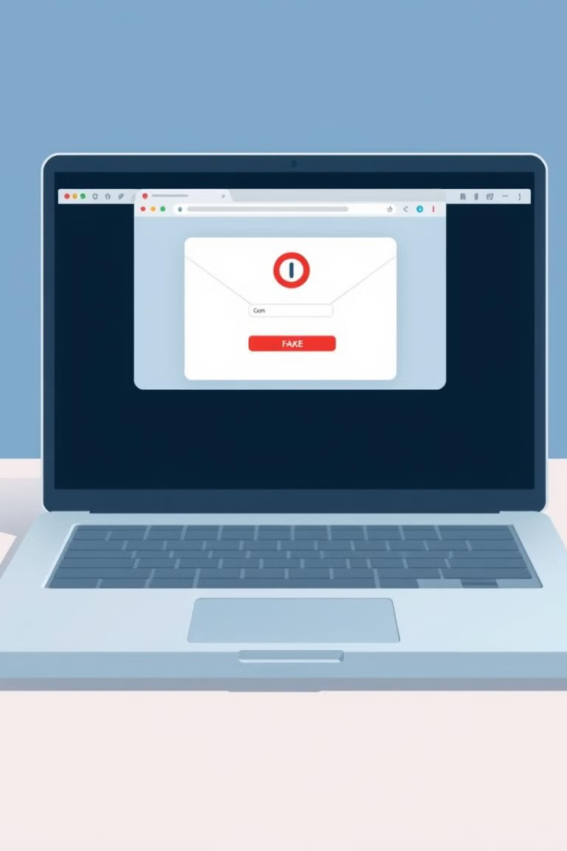



Email Phishing
Fake Login Pages
Urgent Requests
Attackers create fake login pages that mimic legitimate websites to steal credentials.
Emails requesting immediate action, such as password changes or account confirmations, could be phishing attempts.
Promised Rewards
Be wary of emails offering enticing rewards or discounts, which are often used to lure victims.

Slide 6
Preventing Phishing Attacks
Strong Passwords
1
Use unique and complex passwords for all online accounts.
2
Two-Factor Authentication
Enable two-factor authentication for added security.
Anti-Phishing Software
3
Install anti-phishing software to protect against phishing attacks.
4
Be Cautious
Always be cautious about clicking on links or opening attachments from unknown sources.
Verify Information
5
Always verify the information provided in emails and messages by contacting the organization directly.

Slide 7




Reporting Phishing Incidents
Contact the Organization
If you receive a suspicious email or message, report it to the organization you believe it came from.
Report to Authorities
Report phishing attempts to the appropriate authorities, such as the Federal Trade Commission (FTC).
Forward the Email
Forward the suspicious email or message to your email provider or internet service provider.

Slide 8

Conclusion and Key Takeaways
Phishing is a serious cyber threat, but by understanding its tactics and taking precautions, you can protect yourself from falling victim to these attacks.

